Slide 1

SMART SERVICE COMPANY OVERVIEW

Slide 2
AGENDA
INTRODUCTION
4
PROBLEM DEFINITION
1
ABSTRACT
5
ANALYSIS
2
OBJECTIVE
6
INSIGHTS
3

Slide 3
INTRODUCTION
01
Employee attrition—defined as the gradual reduction in workforce due to resignations or retirements—poses a significant challenge, especially when top talent is lost.
Understanding the factors leading to attrition is essential for improving employee retention, engagement, and overall productivity.
This project leverages HR analytics to uncover patterns in employee data that are associated with attrition.

Slide 4

ABSTRACT
02
This project analyzes a dataset containing detailed information about employees.
Identify patterns and correlations between employee characteristics and their likelihood of leaving the organization (attrition).
Through this analysis, we aim to assist HR professionals in identifying high-risk employees and taking proactive measures to improve retention.

Slide 5
OBJECTIVE
03
Predictive Insight: Identify key indicators.
Pattern Recognition: Discover trends and relationships in the data.
Support Decision Making: Equip HR teams with data-backed strategies to reduce attrition and enhance employee engagement.
Model Development (Optional): Build a predictive model to classify employees into categories such as "Likely to Leave" or "Likely to Stay".

Slide 6

PROBLEM DEFINITION
04
Organizations often struggle with unexpected resignations, which lead to disruptions, additional recruitment costs, and loss of organizational knowledge.
Traditional approaches to managing attrition rely on exit interviews and reactive strategies.
The challenge lies in predicting attrition using available data and understanding which factors contribute most significantly to employee turnover.

Slide 7
ANALYSIS
05
The dataset contains 100 employee records with features, including demographic data (age, gender, education), work-related factors (department, job role, years at company), and satisfactory factors(overtime,attrition).
One key feature, Attrition, indicates whether an employee has left the organization

Slide 8
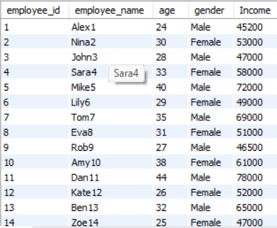
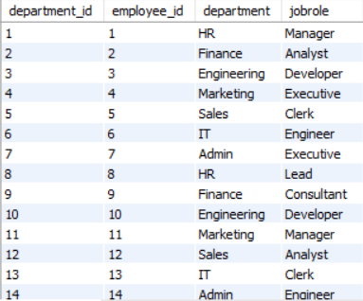
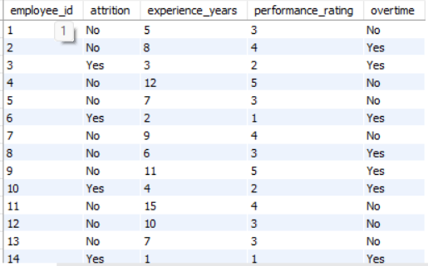
TABLES
EMP
DEPARTRMENT
OFFICE

Slide 9
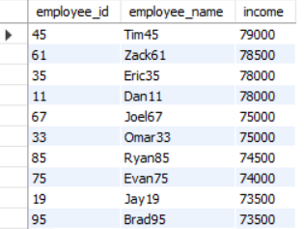
ANALYSIS-1
SELECT EMPLOYEE_ID,EMPLOYEE_NAME,INCOME FROM EMP ORDER BY INCOME DESC LIMIT 10;

Slide 10
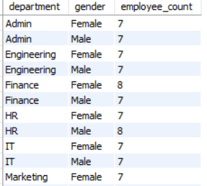
ANALYSIS-2
select d.department, e.gender, count(*) as employee_count
from emp e join department d on e.employee_id = d.employee_id
group by d.department, e.gender
order by d.department, e.gender;

Slide 11
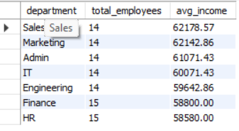
ANALYSIS-3
SELECT d.department,
COUNT(e.employee_id) AS total_employees,
ROUND(AVG(e.income), 2) AS avg_income
FROM emp e
JOIN department d ON e.employee_id = d.employee_id
GROUP BY d.department
ORDER BY avg_income DESC;

Slide 12
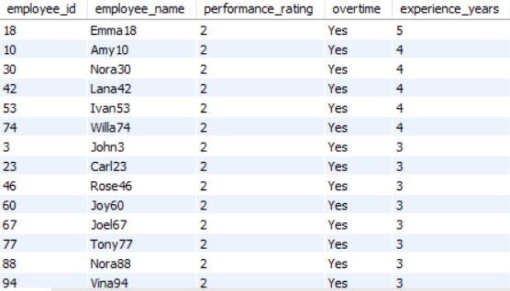
ANALYSIS-4
select e.employee_id, e.employee_name, o.performance_rating, o.overtime,o.experience_years from office o join emp e on o.employee_id = e.employee_id where o.attrition = 'yes' order by experience_years desc ;

Slide 13
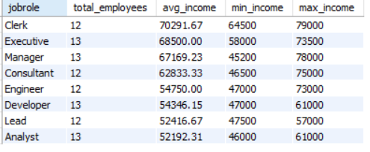
ANALYSIS-5
select d.jobrole, count(*) as total_employees, round(avg(e.income), 2) as avg_income, min(e.income) as min_income, max(e.income) as max_income
from emp e join department d on e.employee_id = d.employee_id
group by d.jobrole order by avg_income desc;

Slide 14
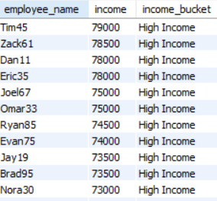
ANALYSIS-6
select employee_name,income, case when income < 40000 then 'low income ' when income between 40000 and 60000 then 'mid income ' else 'high income ' end as income_bucket from emp order by income desc;

Slide 15
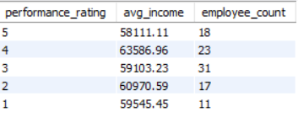
ANALYSIS-7
select o.performance_rating, round(avg(e.income), 2) as avg_income, count(*) as employee_count from emp e join office o on e.employee_id = o.employee_id group by o.performance_rating order by o.performance_rating desc;

Slide 16
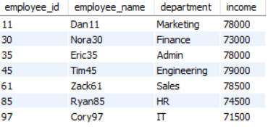
ANALYSIS-8
select e.employee_id, e.employee_name, d.department, e.income from emp e join department d on e.employee_id = d.employee_id where e.income = ( select max(e2.income) from emp e2 join department d2 on e2.employee_id = d2.employee_id where d2.department = d.department);

Slide 17
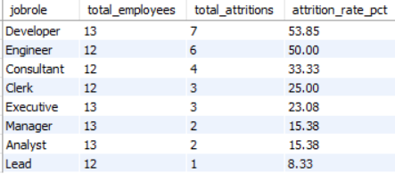
ANALYSIS-9
select d.jobrole, count(o.employee_id) as total_employees, sum(case when o.attrition = 'yes' then 1 else 0 end) as total_attritions, round(100.0 * sum(case when o.attrition = 'yes' then 1 else 0 end) / count(o.employee_id), 2) as attrition_rate from department d join office o on d.employee_id = o.employee_id group by d.jobrole order by attrition_rate desc;

Slide 18
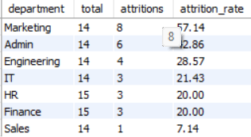
ANALYSIS-10
select d.department, count(*) as total, sum(case when o.attrition = 'yes' then 1 else 0 end) as attritions, round(100.0 * sum(case when o.attrition = 'yes' then 1 else 0 end) / count(*), 2) as attrition_rate from department d join office o on d.employee_id = o.employee_id group by d.department order by attrition_rate desc;

Slide 19
INSIGHTS
06
Younger employees tend to have a higher attrition rate, possibly due to better job mobility.
Employees with lower monthly income are more likely to leave, indicating a possible dissatisfaction with compensation.
Employees working overtime regularly are more prone to attrition, potentially due to burnout or lack of work-life balance.
Some roles like often have higher attrition, possibly due to target pressure or customer-facing stress.
Lower scores in satisfaction metrics strongly correlate with higher attrition.

Slide 20
CONCLUSION
07
The analysis shows that employee attrition is influenced by a mix of personal and professional factors.
High attrition is commonly associated with low income, excessive overtime, poor work-life balance, and low satisfaction scores.
These findings underscore the need for HR departments to implement strategies

Slide 21


